Slide 1

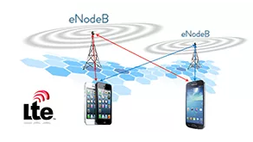
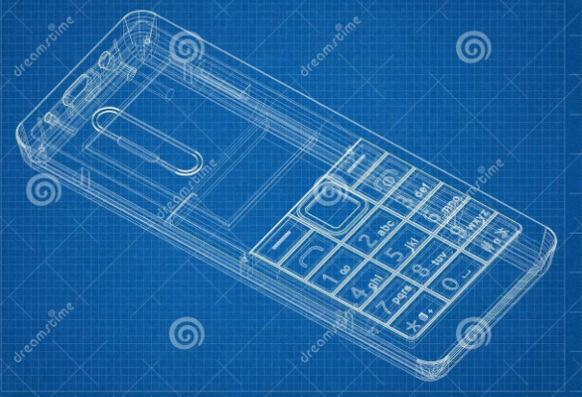
LTE Initial Access
Internal data flow in between Mobile device and air interface

Slide 2
Content
Topics to cover
Layer wise Communication in between device.
Interface between hardware<->Mobile protocols <->air interface
Power on procedure and Initial UE registration to LTE
Frequency search and cell search.
Downlink and uplink synchronization(LTE)

Slide 3
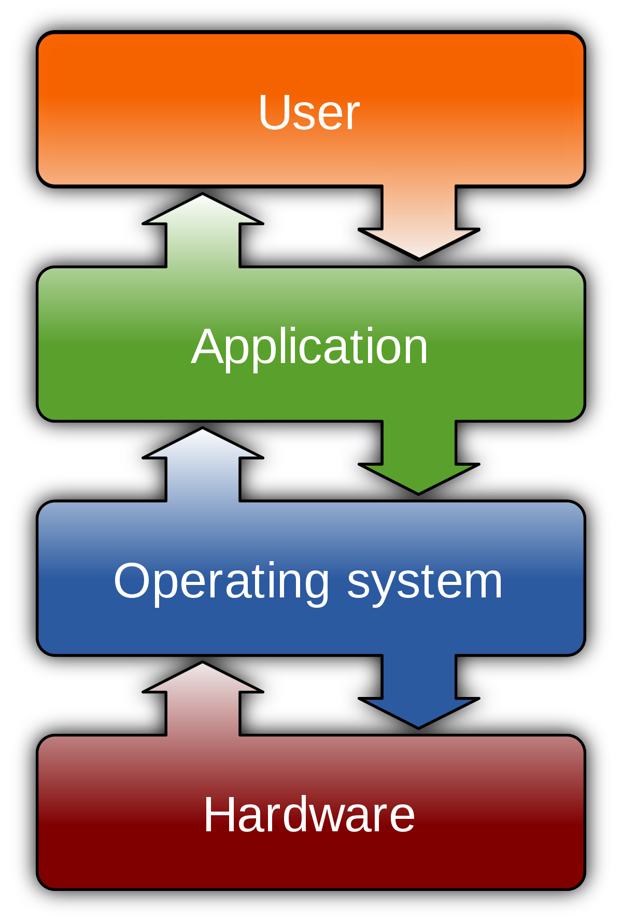
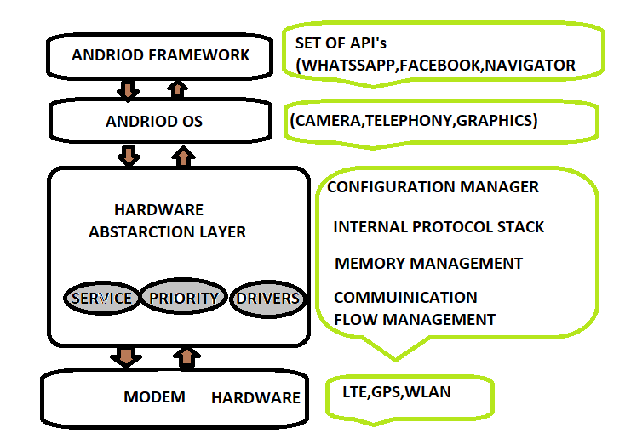
Mobile device layer

Slide 4
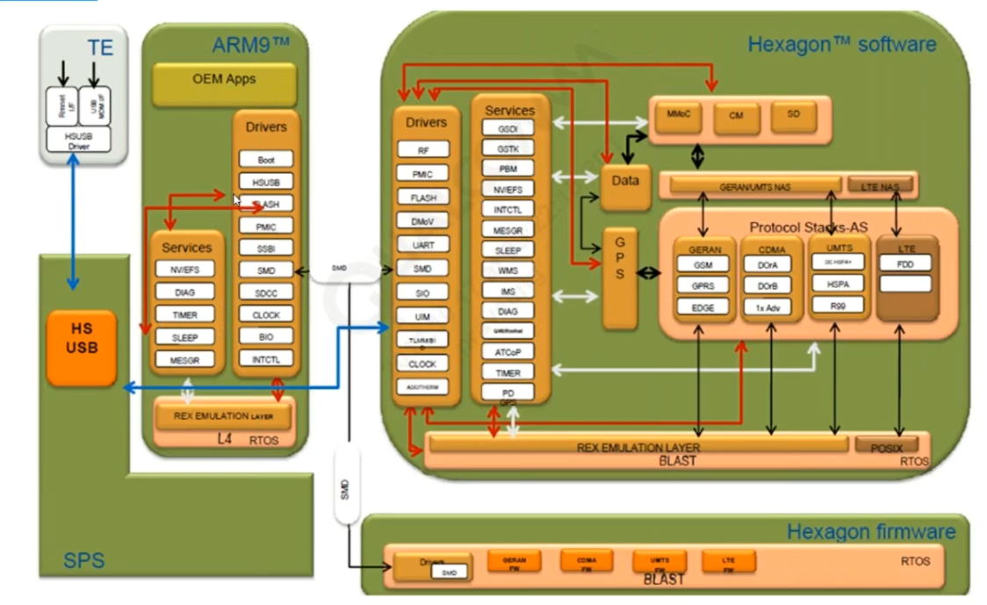
Communication flow inside HAL
Hardware abstraction layer
What is LTE?

Slide 5
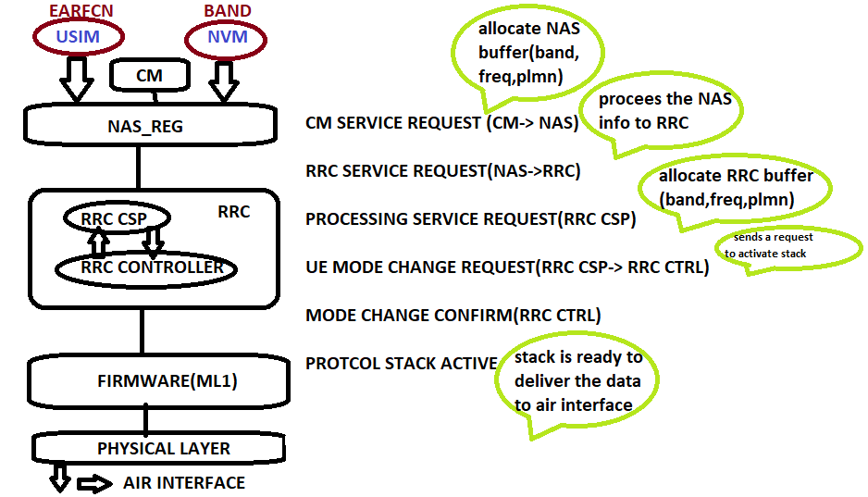
Protocol stack initialization process

Slide 6
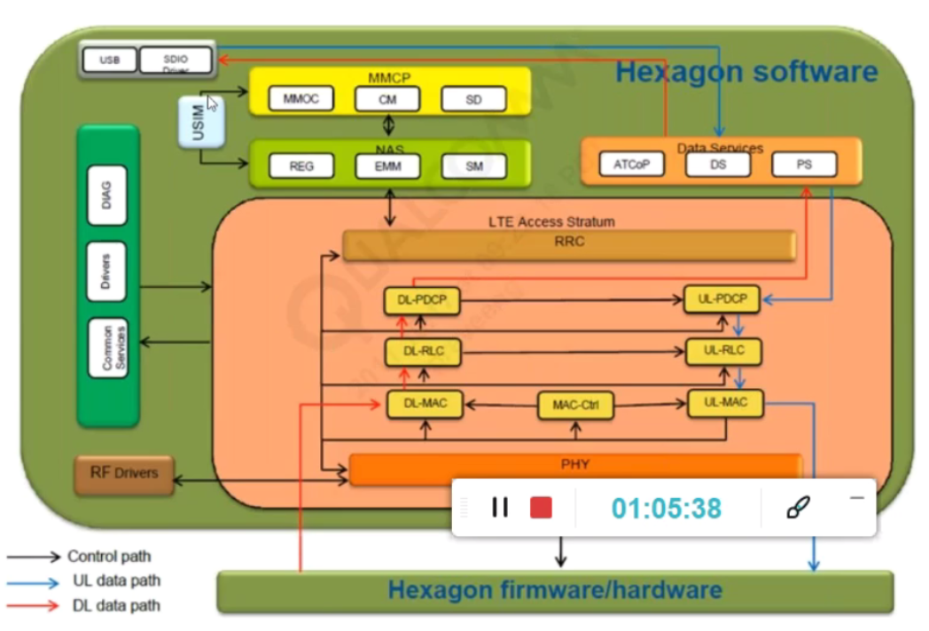
Data flow to and from the mobile protocol stack
Interface between protocol and firmware

Slide 7
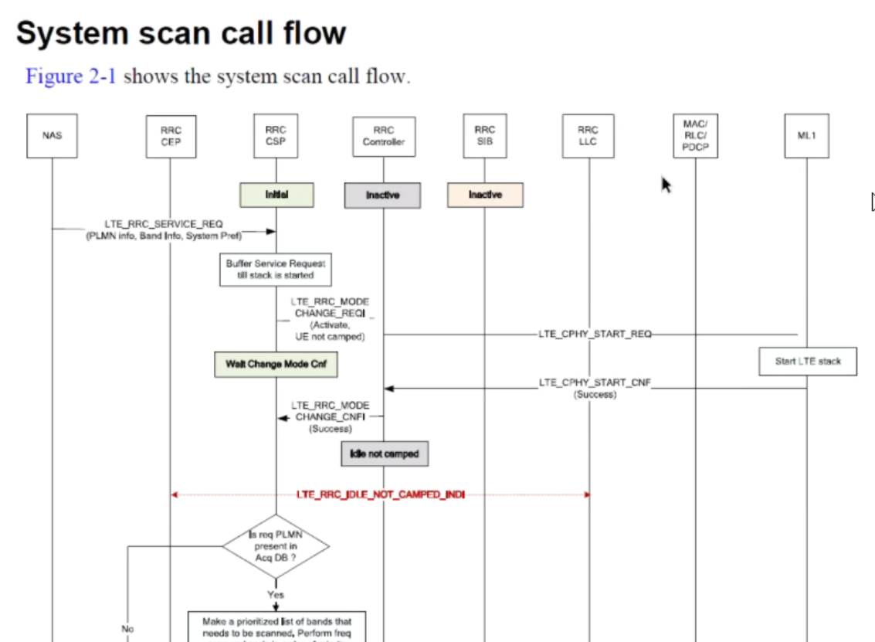
Initial scanning-flow

Slide 8
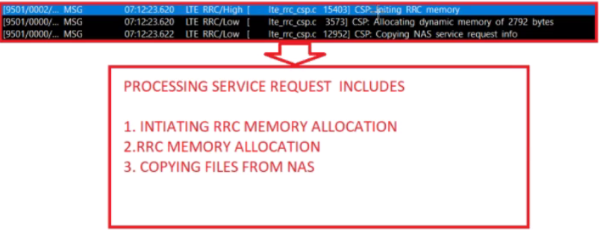
Stack activation QXDM log flow
CM service req
timers
613
RRC_Service_req
618
Processing_service_req
618
RRC buffer_allocation
620
Parameters to use in scan process is stored in RRC buffer

Slide 9
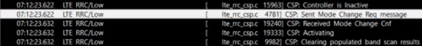
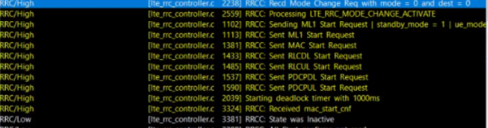
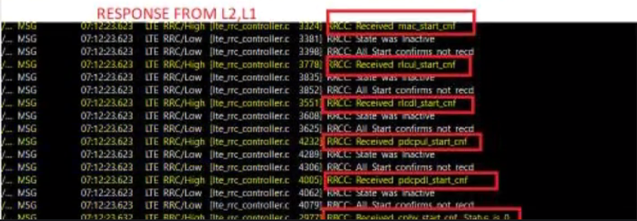
Stack activation QXDM log flow -continue
UE_mode_change_req (Sent)
Protocol stack activivation start
UE_mode_change_req (Received)

Slide 10
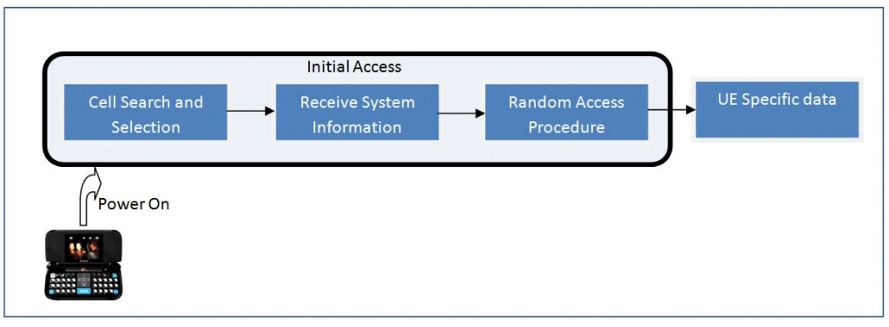
LTE cell acquisition procedure
Frequency scanning
LTE frame structure
PSS(primary synchronization signal)
SSS(secondary synchronization signal)
PCID(physical cell id)
MIB decoding
Cell specific reference signal
SIB decoding
Cell selection

Slide 11
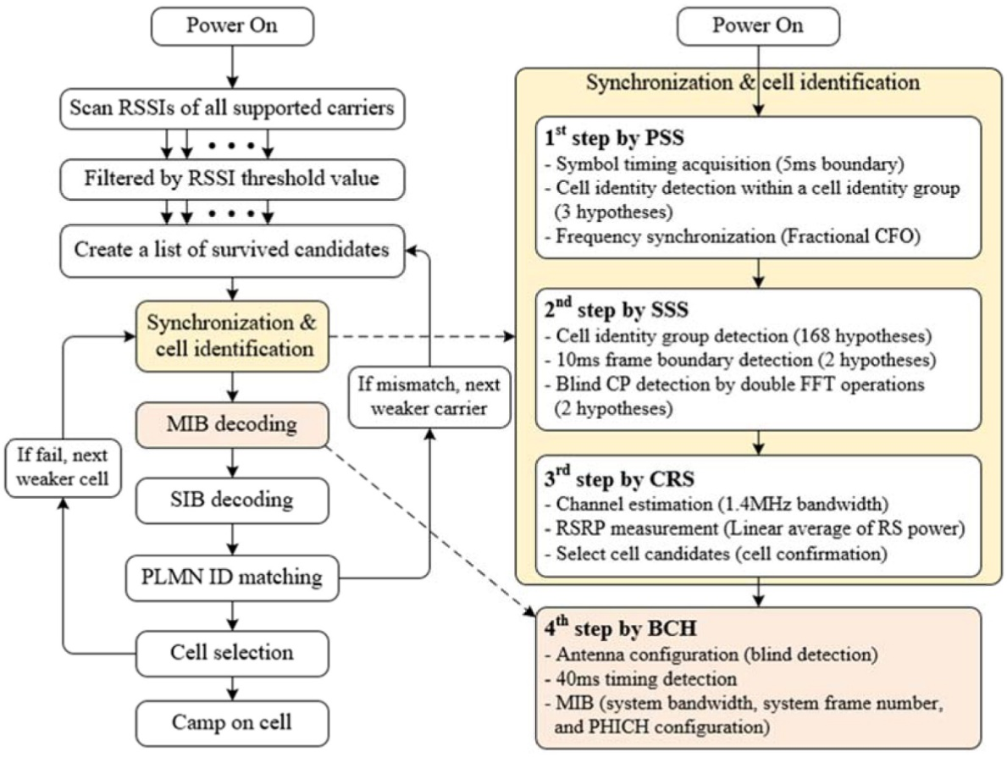
LTE cell acquisition procedure

Slide 12
LTE cell scanning types
Use the last stored information
Complete cell search/scan procedure
System Scan
Band Scan
Available
NAS ADB
PLMN info
RAT priority
Last stored ERFCN
Band info
Bandwidth info
PCID
RRC ADB
Not available
Acquisition data base
UE always prefer system scan
If ACQ data base not available
will prefer band scan
Initially band scan requires when UE
using new sim or 1st time network synchronization
or move to other PLMN and roaming area.
FIRMWARE(ML1)

Slide 13
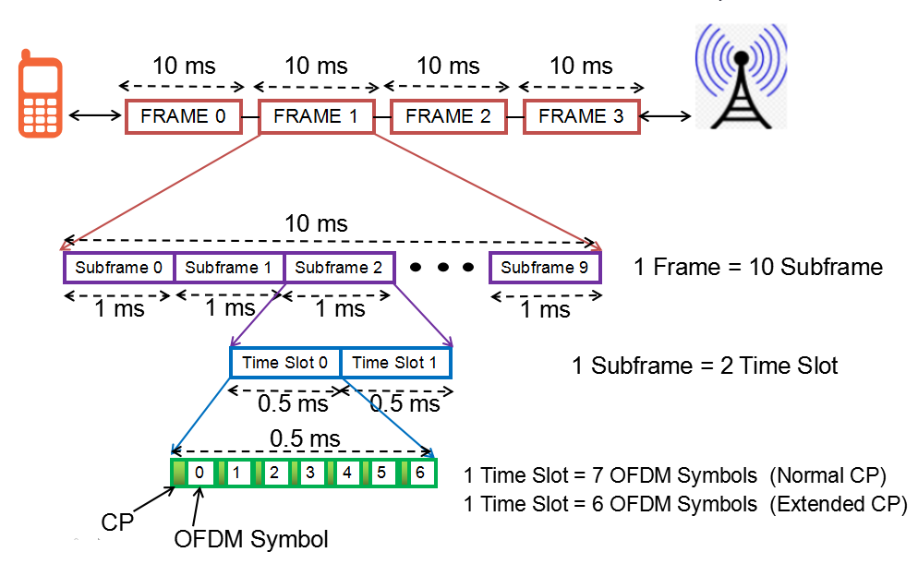
LTE Frame structure(Time domain)
LTE signals will
communicate
Within the frame
Both downlink and uplink structure is same
100 radio frame per second

Slide 14
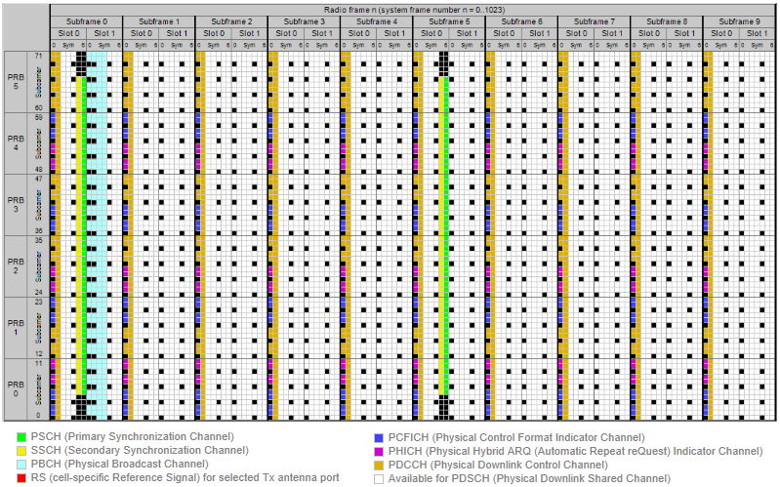
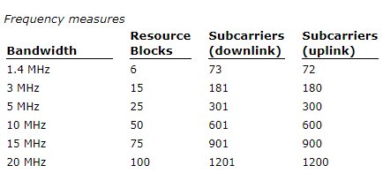
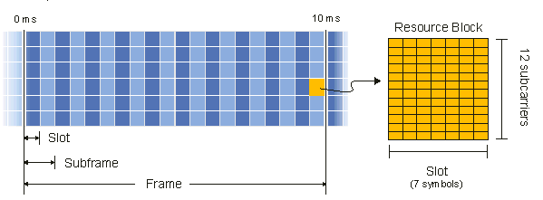
LTE Frame structure(1.4 MHZ)

Slide 15
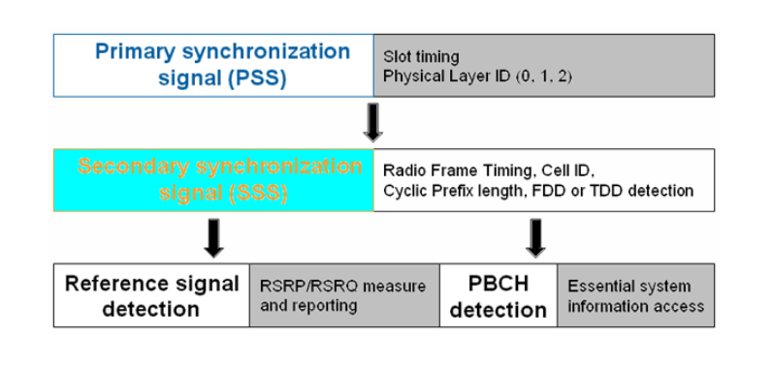
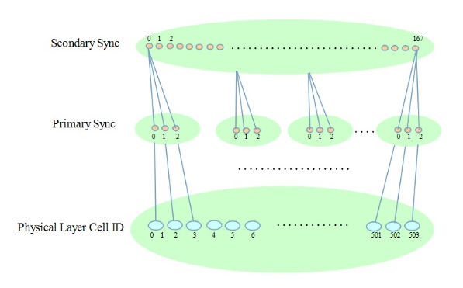
Time and Slot synchronization(PSS/SSS)
Slot synchronization
Frame synchronization
Bandwidth
Antenna configuration

Slide 16
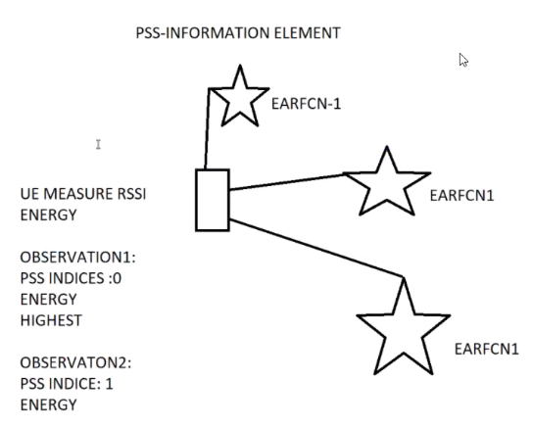
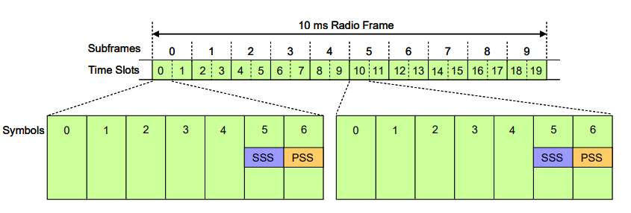
Time synchronization(PSS)
Enodeb1
When UE started searching for his supported EARFCN, Enodeb will send the PSS information in every 5 MS to UE
Enodeb2
Mobile
Enodeb3
UE will decode that particular PSS which is having highest energy with in the 1 radio sub frame

Slide 17
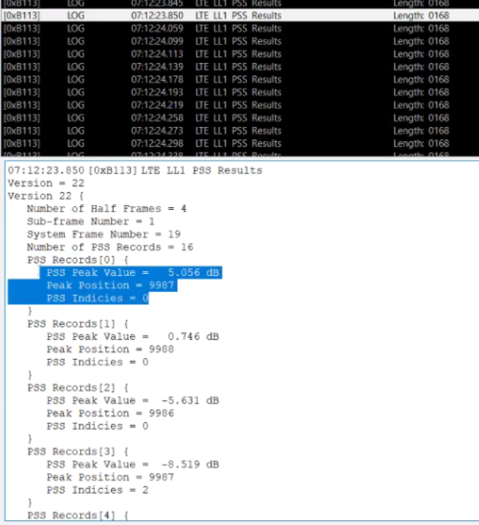
Time synchronization(PSS)-QXDM
Selects the highest
Peak value
PSS indices differenciate
According to EARFCN
No OF PSS records indicate
The no of Enodeb’s connected
Or near by to UE

Slide 18
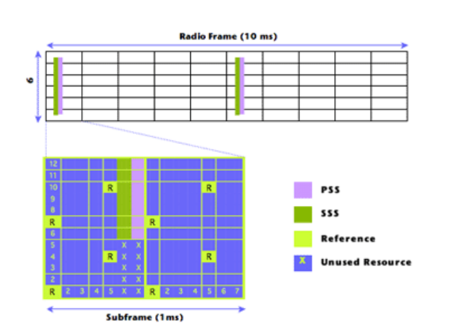
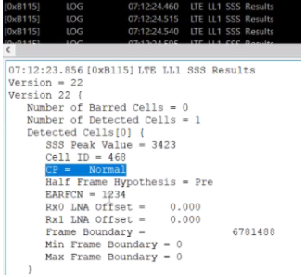
Frame synchronization(SSS)
After immediately receiving the PSS UE will decode the SSS just before the PSS decodes in each radio frame.
Energy of SSS according to PSS
Got the physical cell ID
Cyclic prefix information
Frame synchronization

Slide 19
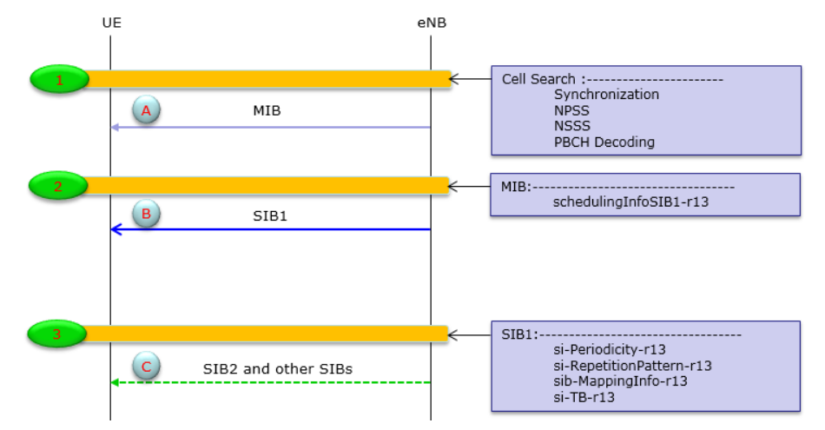
Downlink Synchronization(MIB/SIB)
MIB-NB contains all the information required to acquire SIB1,
system band width and transmission mode
SIB contains all the downlink information which will be used by UE
For further Uplink sync process and contains required parameters
for each UE initiating service

Slide 20
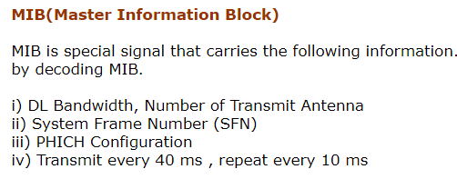
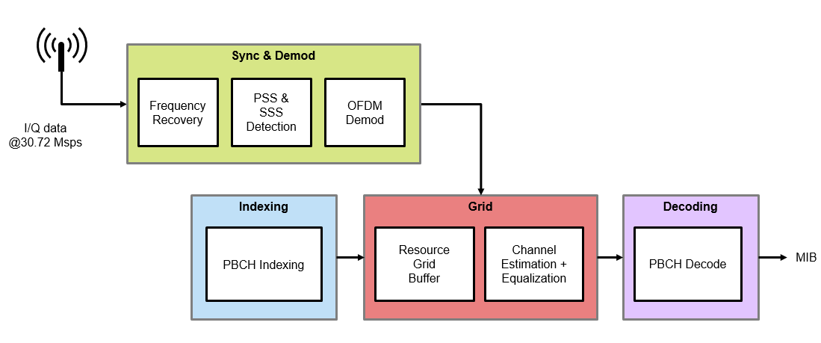
MIB decoding (Master information block)
Now UE got a phy cell id to communicate with NW, so now channel concept will begin
MIB can be decoded by UE after decoding of PBCH

Slide 21
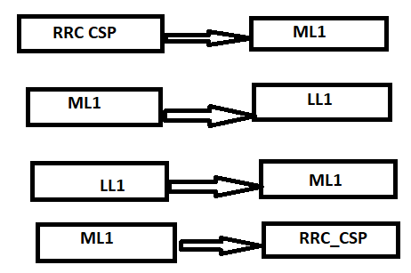
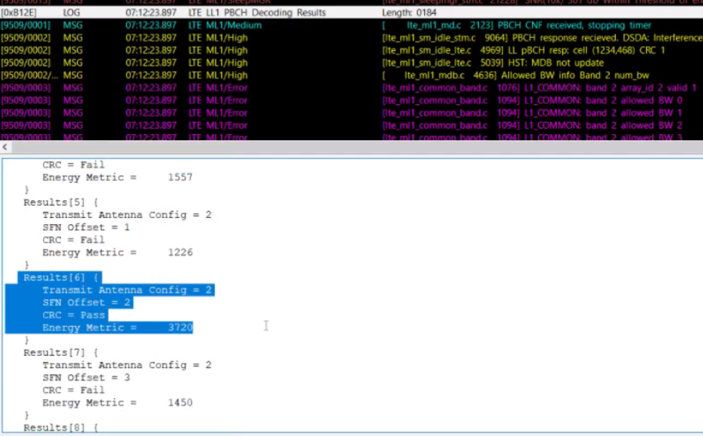
MIB decoding (Master information block)-channel initialization
Wants to start MIB decoding
MIB decode complete
When your cycle redundancy check will pass , it will
start configuring antenna and channel information
CRC will pass where that particular PBCH decoding status
element having the highest energy .

Slide 22
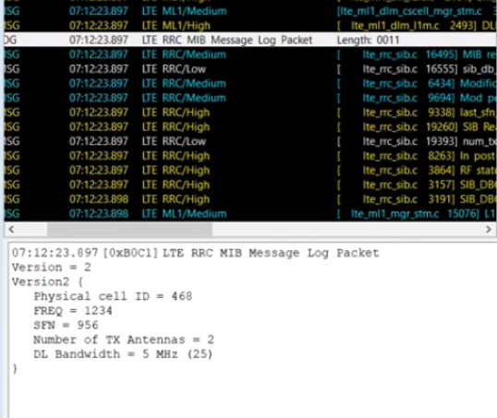
MIB decoding (Master information block)-QXDM
From MIB we got the bandwidth information
Antenna configuration
Frequency info
SFN
UE will receive the MIB signals in 2nd time slot-first 4 OFDM symbols of the each radio frame.

Slide 23
SIB decoding (System information block)
SIB Decoding in LTE
i) Found Cell Access Related Information – #PLMN Identity List, #PLMN Identity, #TA Code, #Cell identity & #Cell Status ii) Cell Selection Information – Minimum Receiver Level iii) Scheduling Information – SI message type & Periodicity, SIB mapping Info, SI Window length
The UE has synchronized itself with the Cell with the help of #PSS and #SSS; followed by reading the MIB. Now, UE will proceed to read SIB1 and SIB2 which carriers important information for the UE to select a Cell.
Why SIBs are needed?
SIBs carry relevant information for the UE, which helps UE to access a cell, perform cell re-selection, information related to INTRA-frequency, INTER-frequency and INTER-RAT cell selections.

Slide 24
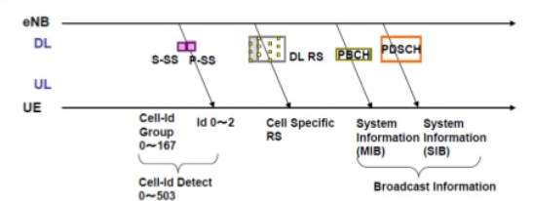
SIB decoding (System information block)
In LTE SIB is mandated to be transmitted for any cells. Since many of the SIB are transmitted, it should be transmitted in such a way that the location (sub frame) where a SIB is transmitted should not be the same subframe where another SIB is transmitted.

Slide 25
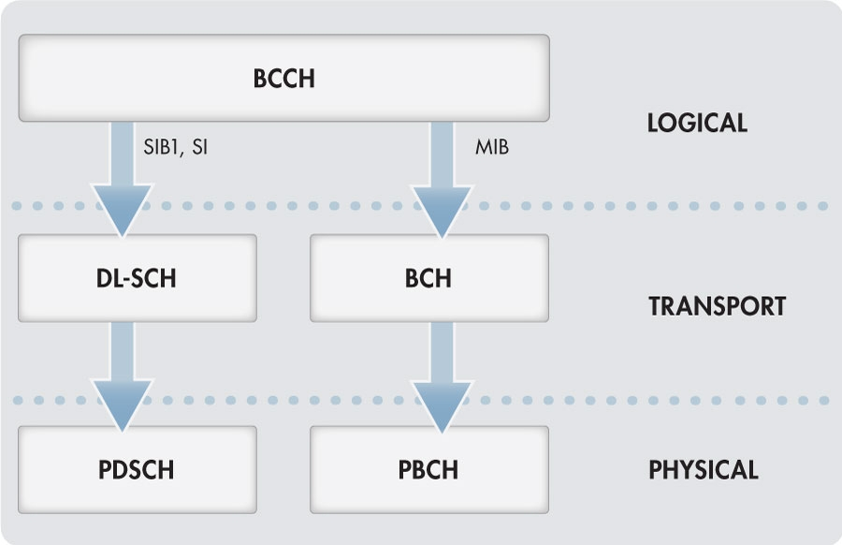
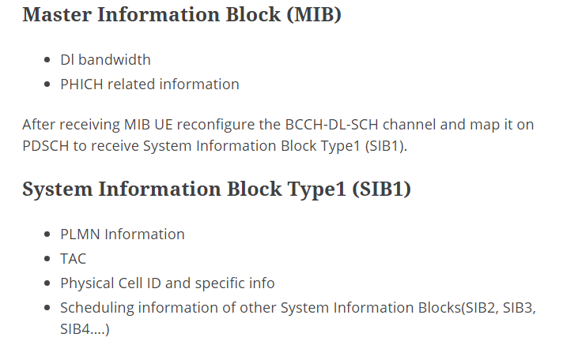
SIB decoding (System information block)
RLC
MAC
LL1

Slide 26
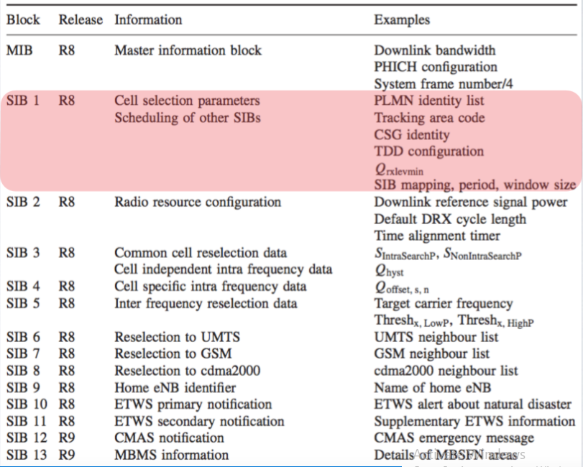
SIB/MIB- information

Slide 27
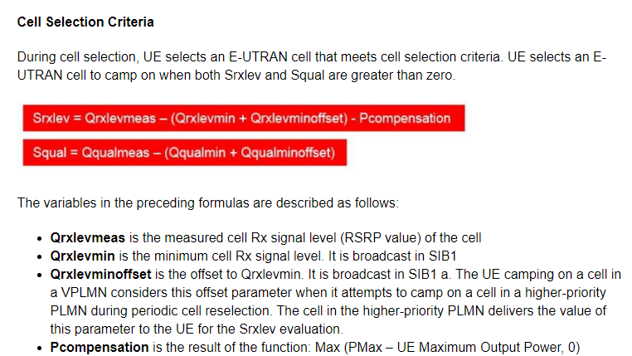
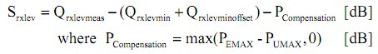
Cell selection criteria

Slide 28
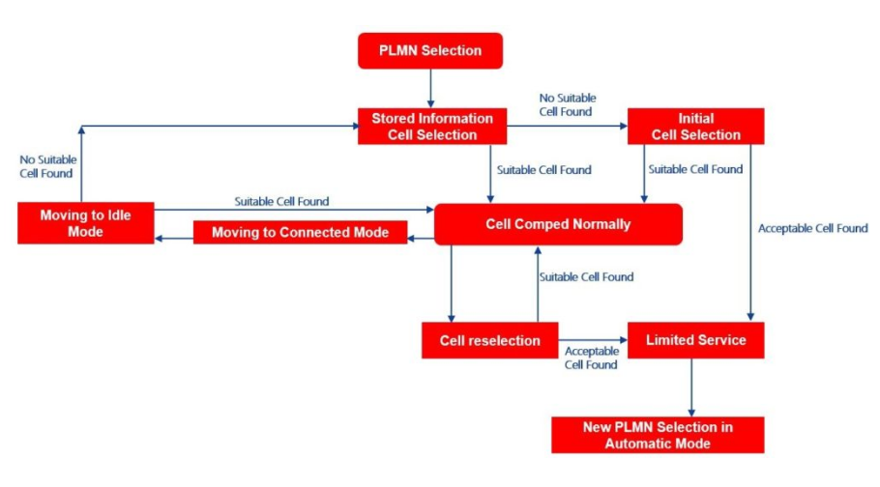
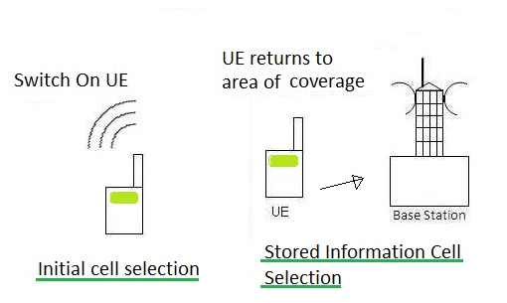
Cell selection and reselection cycle

Slide 29
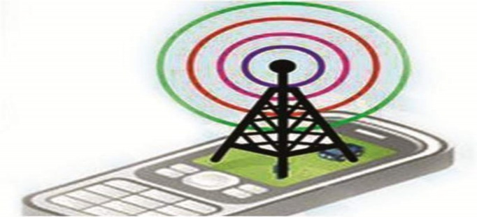
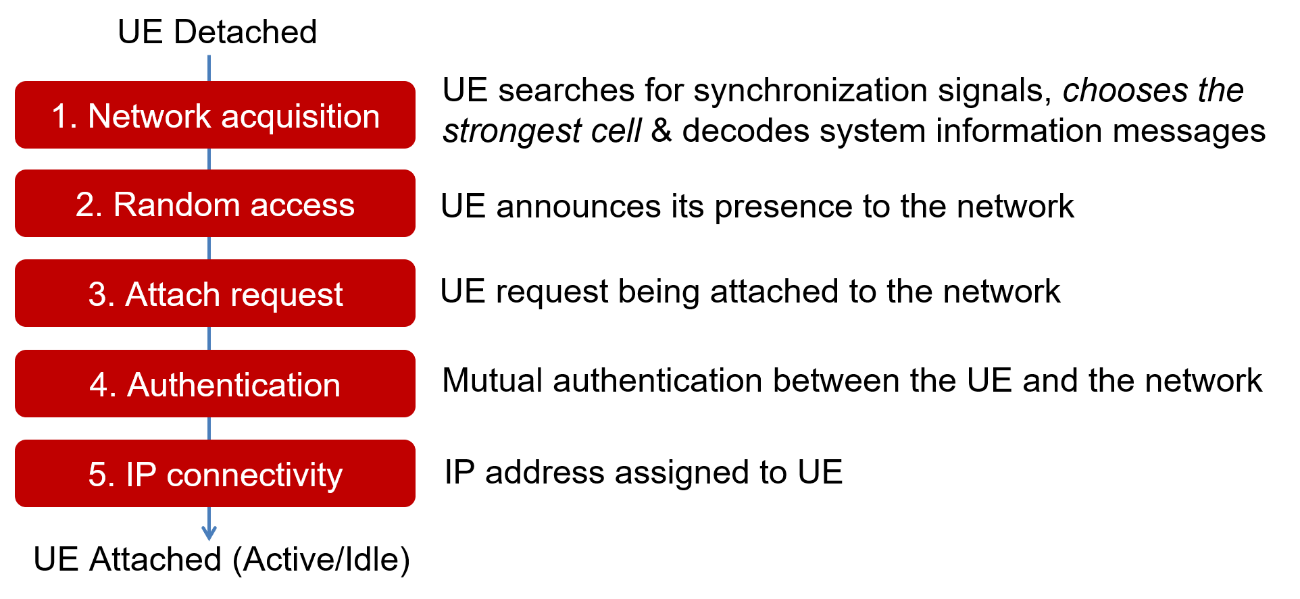
Flow between UE and Network

Slide 30
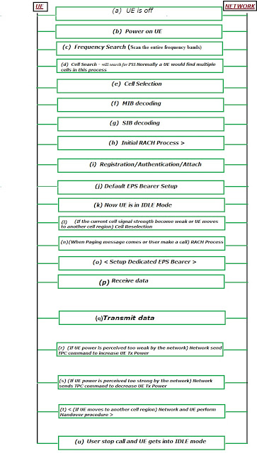
Complete signaling flow

Slide 31
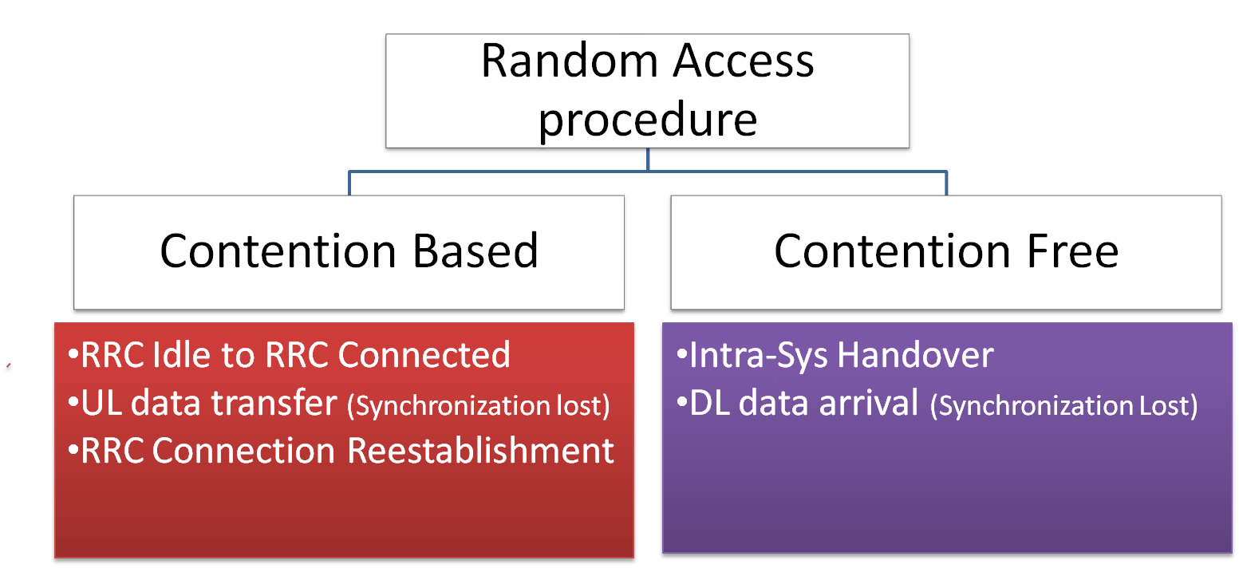
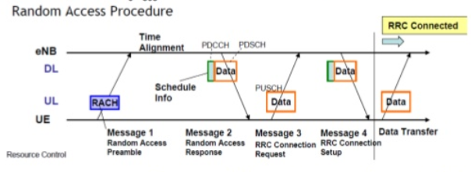
RACH procedure(initial UE massage to network)
Why RACH ? (What is the functionality of RACH ?)
i) Achieve UP link synchronization between UE and eNB
ii) Obtain the resource for Message 3 RRC Connection Request)

Slide 32
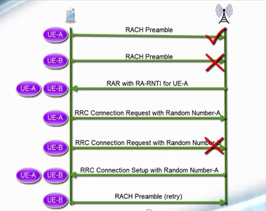
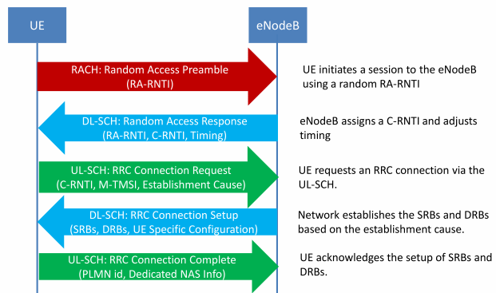
RACH and RRC procedure
When UE will try to start any service (CS/PS), it has to initiate RACH process
After receiving the identity , UE will start the signaling process using RRC connection

Slide 33
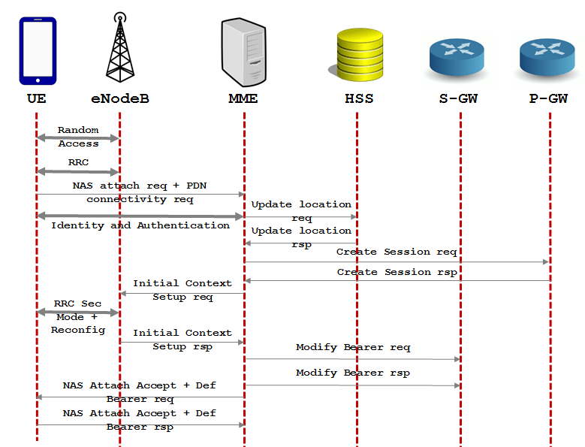
LTE attach and authentication process
Once the default bearer setup complete, signaling part is over and traffic part will start

Slide 34
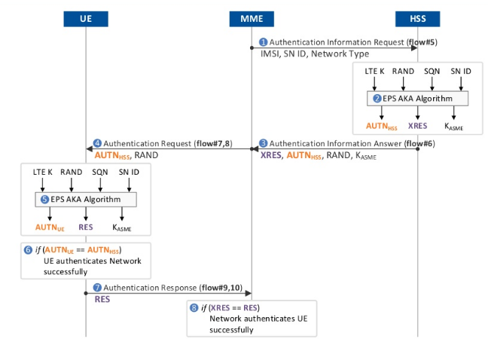
LTE authentication process
Authentication is a process by which UE and Network check if the other party has right authority to communicate each other. ... In LTE (in WCDMA as well), Network authenticate UE and UE also authenticate the Network. Authentication on both side should be passed for the communication to proceed.

Slide 35
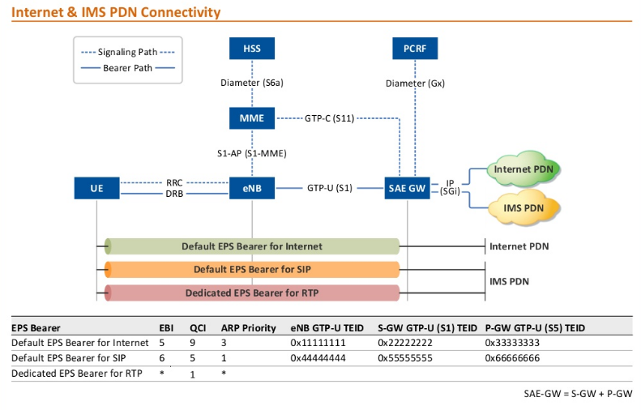
LTE EPS bearer
In a mobile network using the Long Term Evolution (LTE) architecture, bearers are the tunnels used to connect the user equipment to Packet Data Networks (PDNs) such as the Internet. In practice, bearers are concatenated tunnels that connect the user equipment to the PDN through the Packet Data Network Gateway (P-GW).

Slide 36
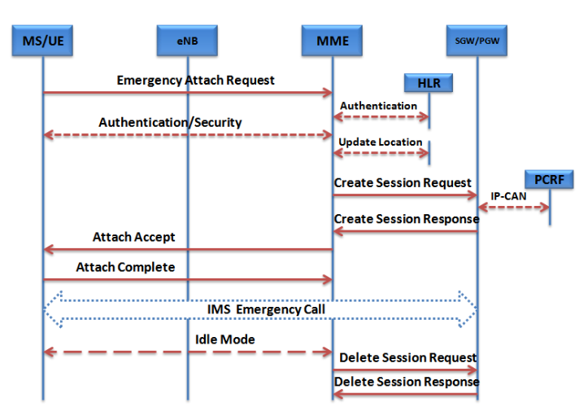
LTE call flow from attach to detach

Slide 37

Thanks

